Slide 1


Installation Guide
Urban Decision Theater 1.0
Developers: Olena Tkachenko and Renan Santana Product Owners: Ali Mostafavi, Leonardo Bobadilla
Notes:
Hello!
This is the installation guide for Urban Decision Theater 1.0
Our developers are: Olena Tkachenko and Renan Santana.
And our product owners are Dr. Ali Mostafavi and Dr. Leonardo Bobadilla.

Slide 2
Pre-requisites
Software and hardware required in development environment:
> Development Environment:
1. Mac OS 10+, Windows 10+
>Unity 5.1
Software required in remote host server environment:
> Linux Distribution OS (Ubuntu 14.x, Cent OS,..)
> MongoDB 3.2
Notes:
The software pre-requisites are split into 2 sections.
The software required for the development in the development environment and the software required in the remote host environment
The development environment can run on a MacOS and Windows operating systems and require the installation of Unity 5.1 game engine.
On the remote host server, in our case the Ubuntu 14.04 server, we required the installation of MongoDB server.

Slide 3
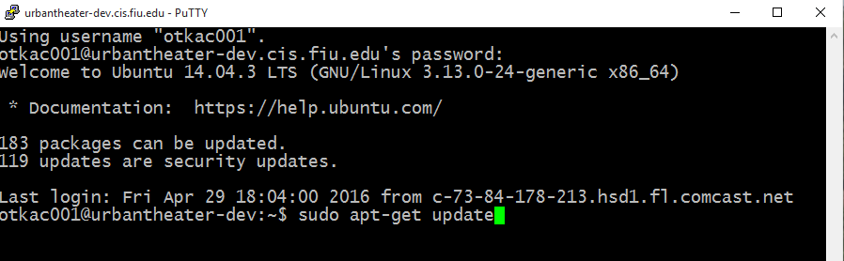
Setting up the database in the server
Notes:
First things first, on our Ubuntu remote server, we need to update package versions and dependencies with: sudo apt-get update command.

Slide 4

Install MongoDB
Follow this link for latest instructions on installing MongoDB community edition:
> https://docs.mongodb.org/manual/tutorial/install-mongodb-on-ubuntu/
We used the following commands for installation:
sudo apt-key adv --keyserver hkp://keyserver.ubuntu.com:80 --recv EA312927
deb http://repo.mongodb.org/apt/ubuntu trusty/mongodb-org/3.2 multiverse" | sudo tee /etc/apt/sources.list.d/mongodb-org-3.2.list
sudo apt-get update
sudo apt-get install –y mongodb-org
Notes:
Next, we execute these commands on your remote Ubuntu 14.04 server to install MongoDB. The link details the latest installation instructions.
MongoDB is already installed in our urbantheater-dev.cis.fiu.edu remote server.

Slide 5
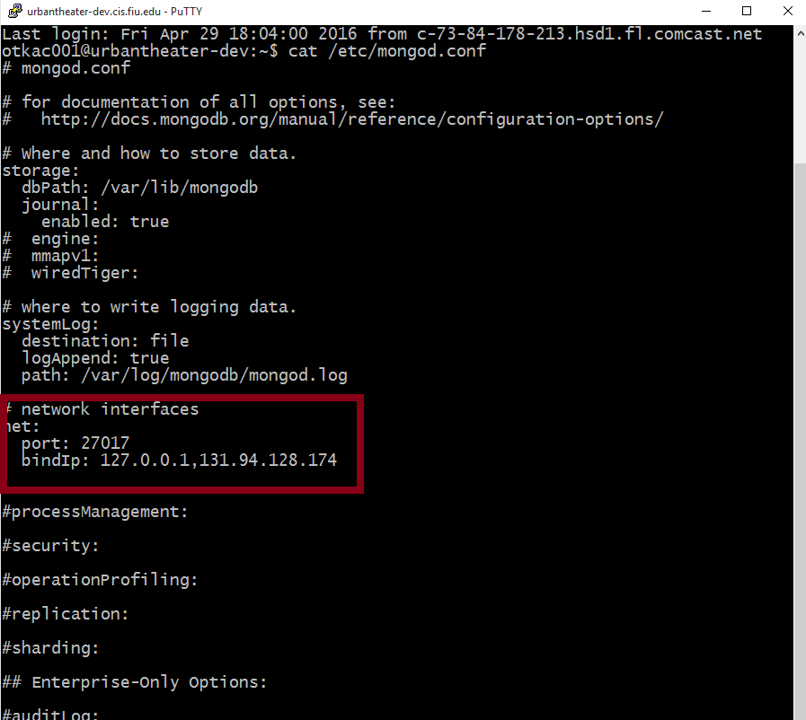
Install MongoDB
In order to allow remote connection to this mongo server, the public ip of your remote server needs to be added to the bindIp list of /etc/mongod.conf file.

Slide 6
Install MongoDB
Restart MongoDB service:
> sudo service mongod restart
Notes:
After this is done. The mongo service needs to be restarted with the above command.

Slide 7
Installing Urban Theater
Notes:
This section of the video describes the steps to open and build Unity Theater application.

Slide 8
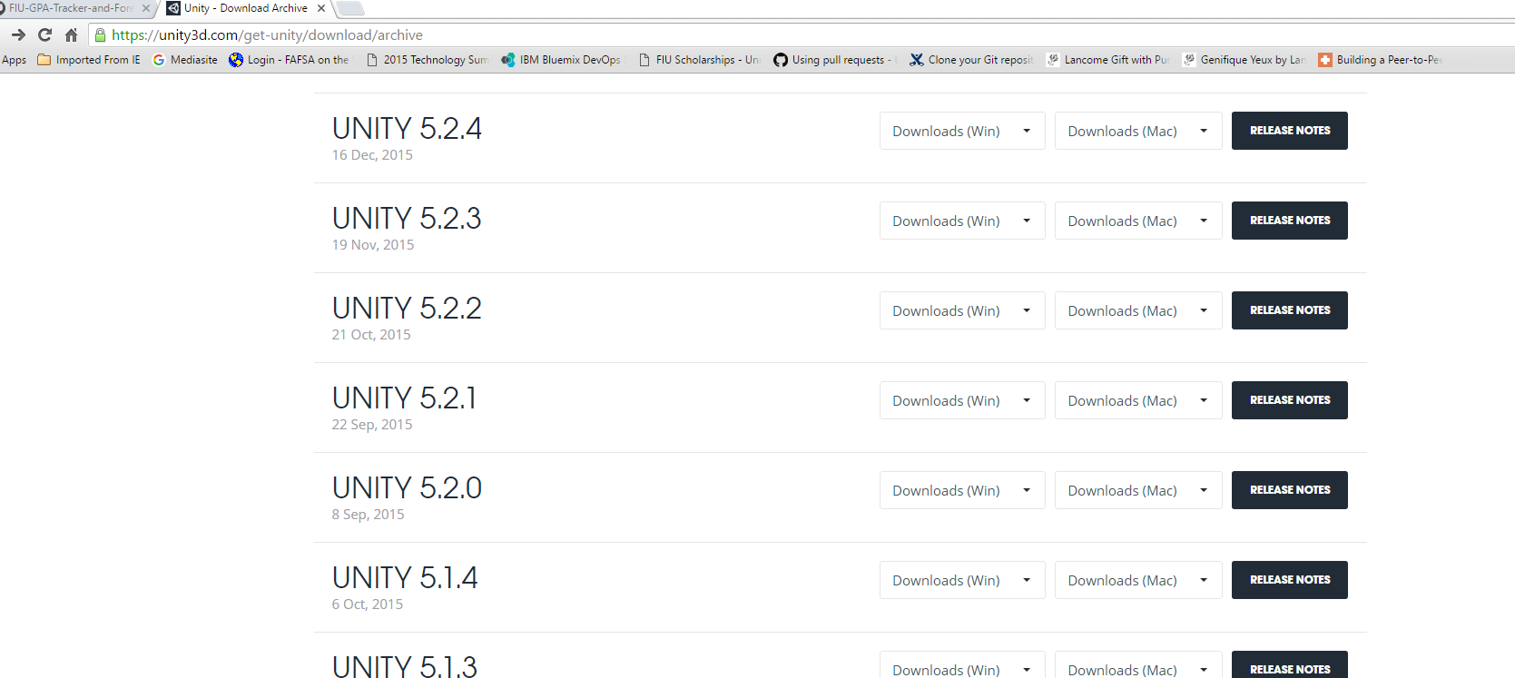
Notes:
First you will need to install Unity 5.1.4 GameEngine.
Go to https://unity3d.com/get-unity/download/archive to download.

Slide 9
git Clone or download Urban Theater project using this link:
https://github.com/FIU-SCIS-Senior-Projects/UrbanTheater

Slide 10
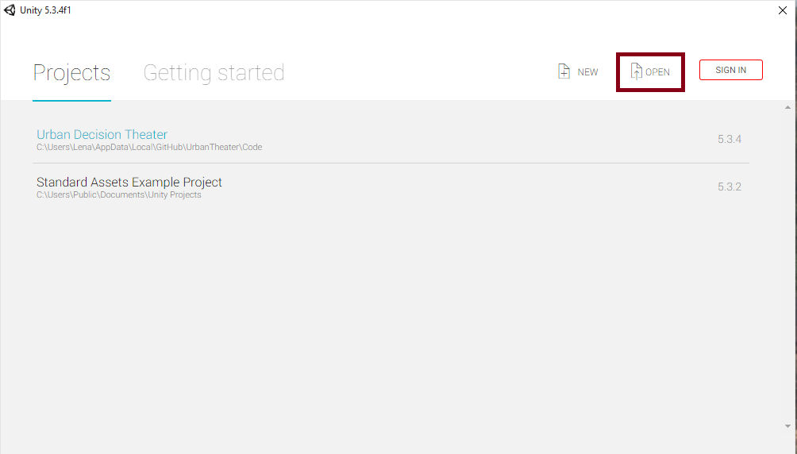
After installing Unity Game Engine open the Urban Decision Theater Project under the Code directory.

Slide 11
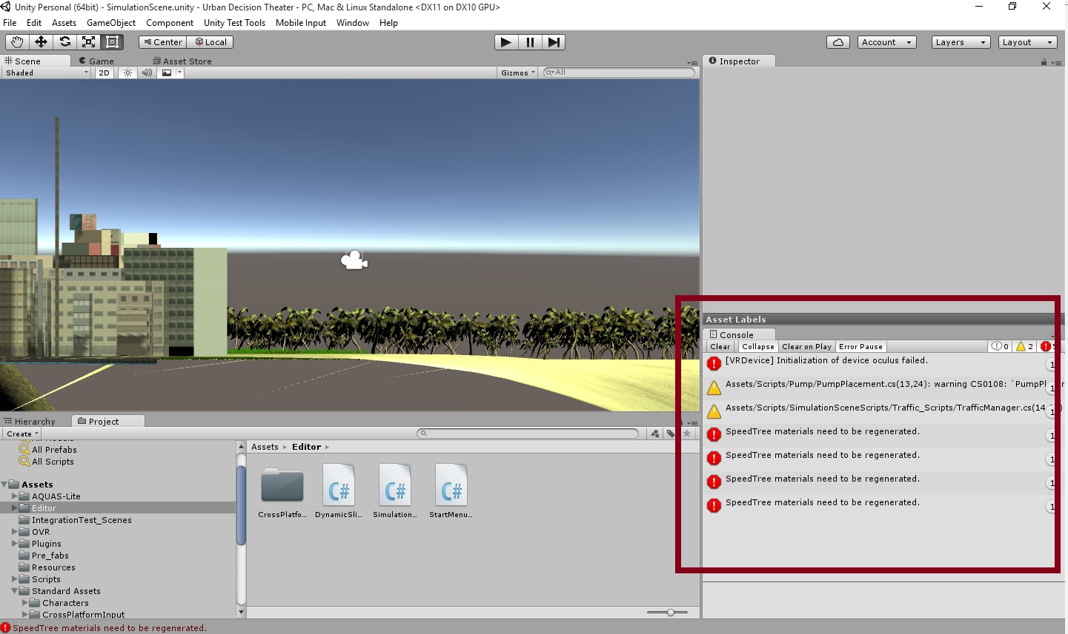
Red Errors in the Console tab.
Notes:
When the project is first opened from source code provided, you will get a lot of red octagon errors in the Console.
The first VRDevice error you can ignore because that means that oculus is not connected to this system and it wont interfere with making a build.

Slide 12
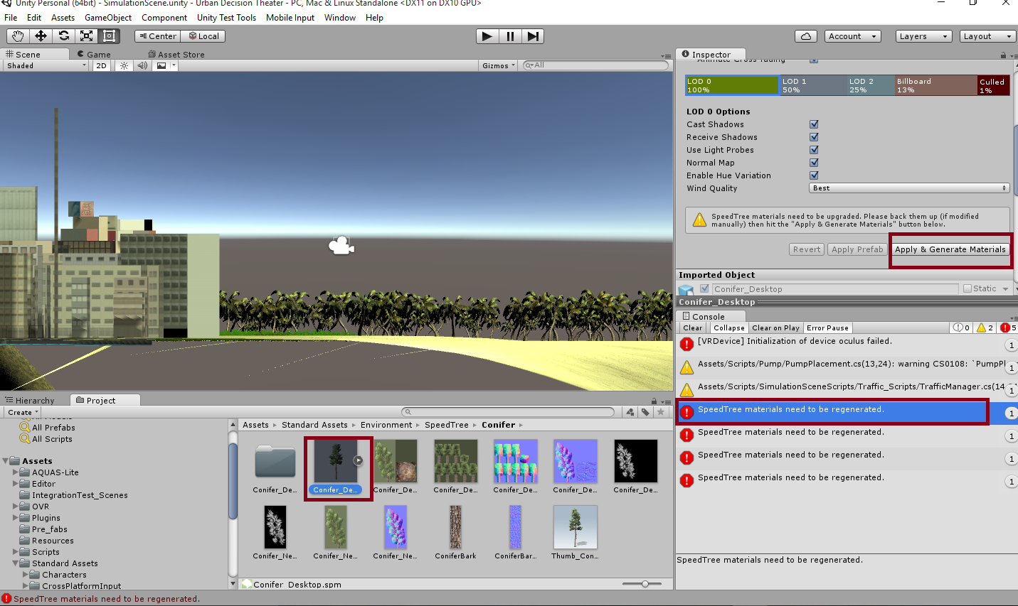
Resolve SpeedTree Errors in the Console tab.
Notes:
To resolve the spreedTree errors in the console.
For each error:
Click on the console speed tree error
A tree prefab will be highlighted in blue on the middle-bottom tab, click on it. This will bring up and Inspector options tab for it, located in the top right side.
In the Inspector click the “Apply and Generate Materials” button so that the Error in the Console will be resolved.

Slide 13
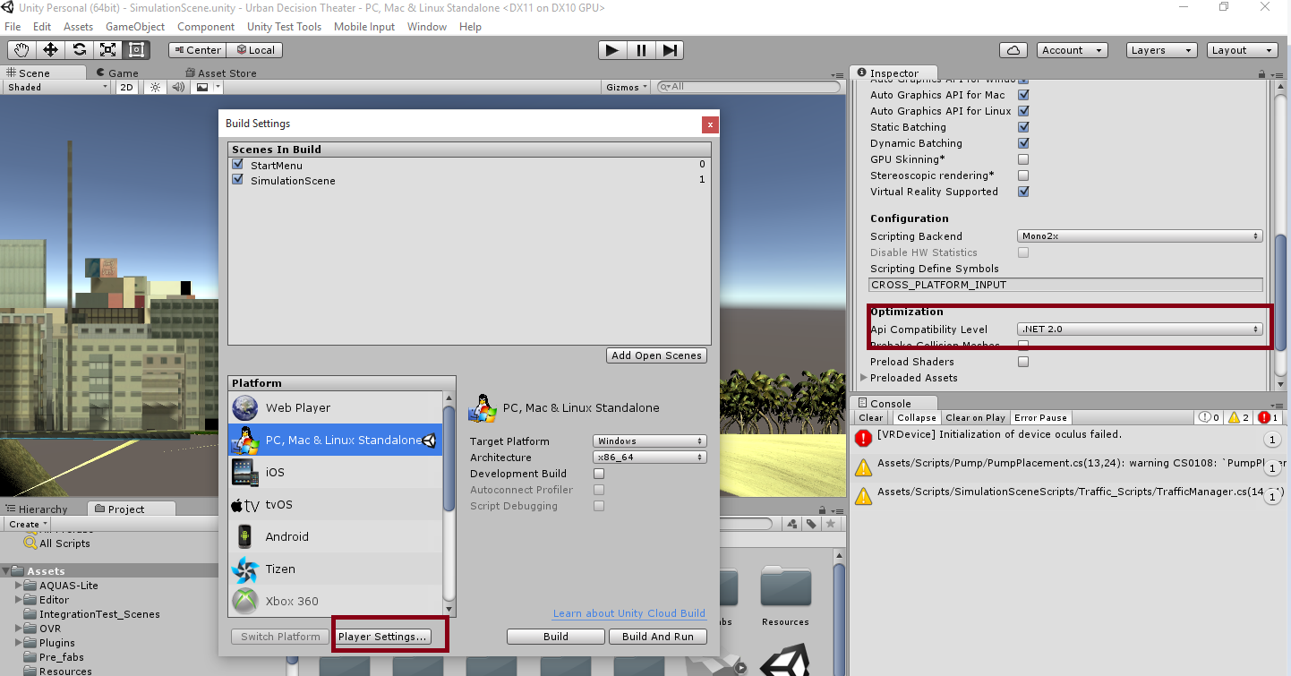
Build:
Notes:
For making a build or executable of your application.
Go to File>Build Settings>Player Settings>
scroll down in Inspector until you see the Optimization section and select .NET 2.0 for Api Compatibility Level.
After making that change click the “Build AND Run” Button in Build Settings to create an executable of your game.

Slide 14
The END.
Thank you for your time.
Notes:
Thank you for your interest in Urban Theater!!!

